Slide 1
Doing your
FSAID

Slide 2
First, what is FAFSA?
Provides money towards college tuition, in federal student loans.
Stands for: Free Application for Federal Student Aid
Opens the opportunity for you to be given grants and scholarships (which you do not have to pay back)
Allows you to work on college campuses (Federal Work Study)
Makes it easier to request a loan for college

Slide 3
What is a FSAID and why complete it now?
A FSAID (Federal Student Aid Identification) is necessary to complete because it acts like your “electronic signature” for anything concerning a FAFSA Application
Your FSA ID is required to submit a FAFSA- For you & 1 parent.
Your FSAID takes up to 3 days to finally be processed. Therefore, if you complete it early you won’t have to worry about waiting when filling out your FAFSA later.
The faster you complete your FAFSA, the faster you will attain more opportunities to scholarships, grants, and student aid.

Slide 4
Lets begin!

Slide 5
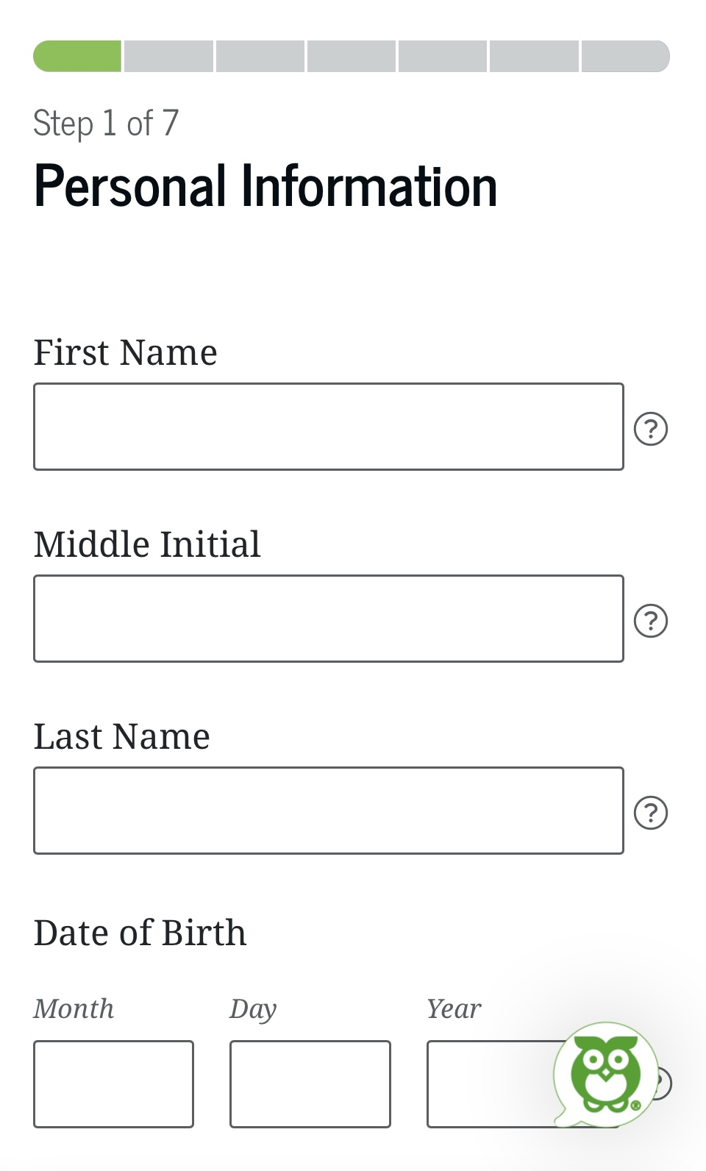
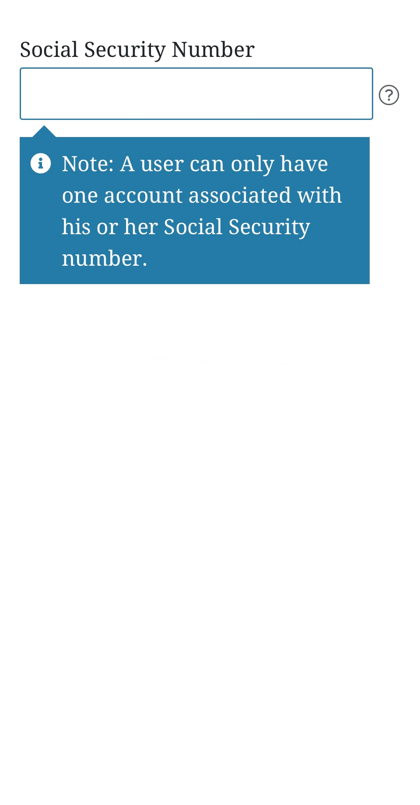
01
Step
Go to https://studentaid.gov/fsa-id/create-account/launch
Click “Get Started”
Fill in the personal information page
(Name, DOB, SSN)

Slide 6
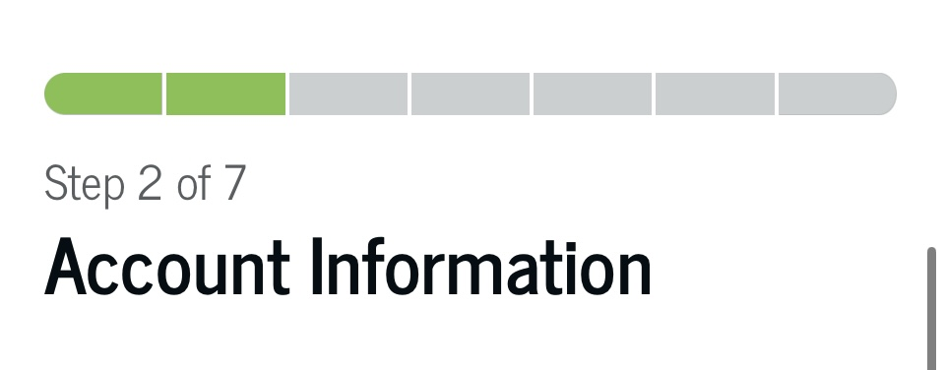
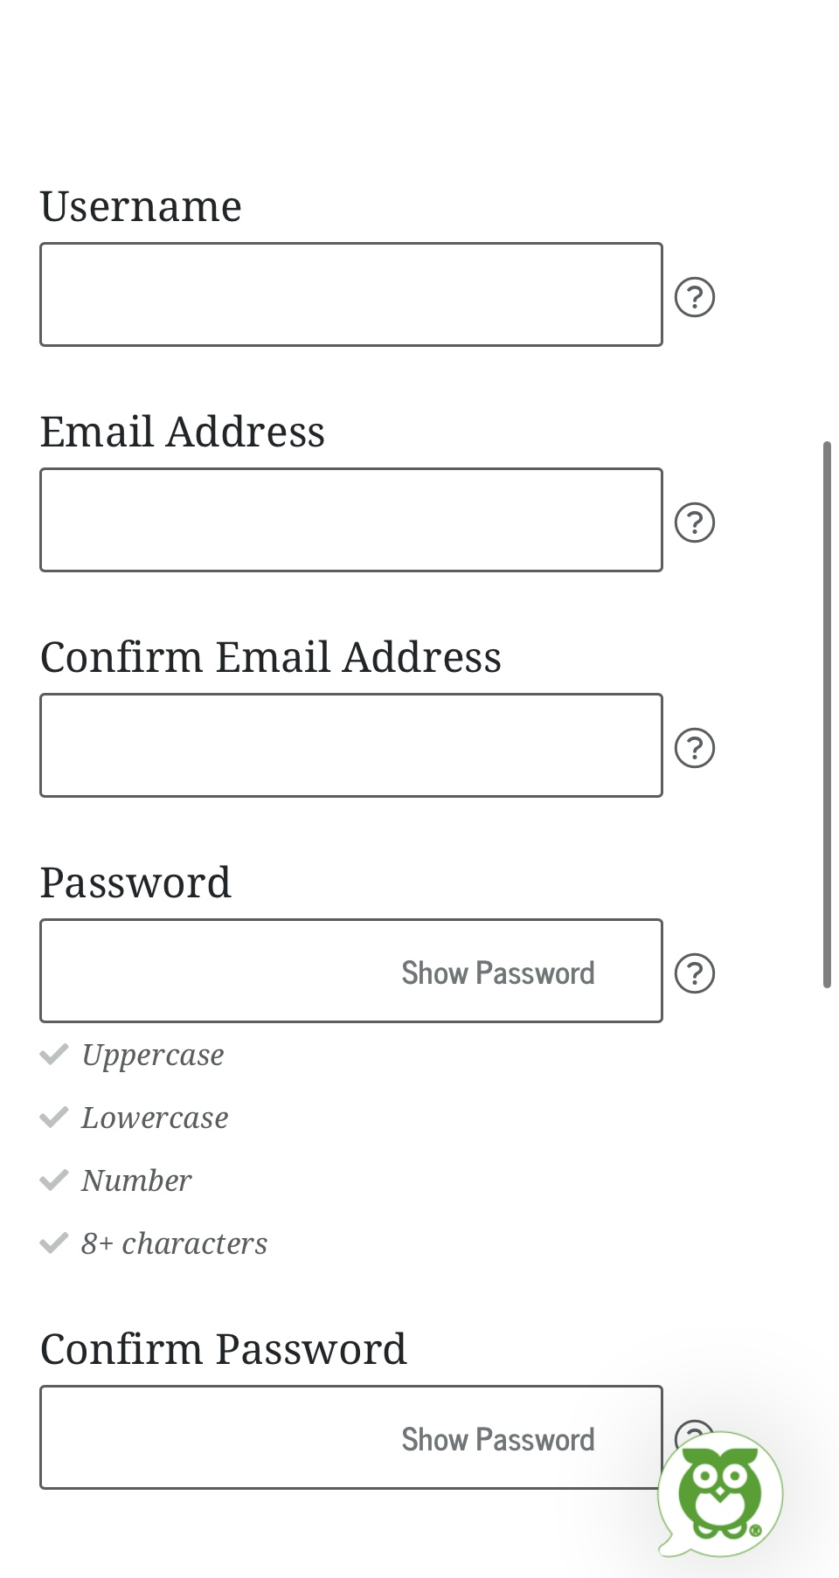
Step 02
Make an account with a username, email, and password

Slide 7
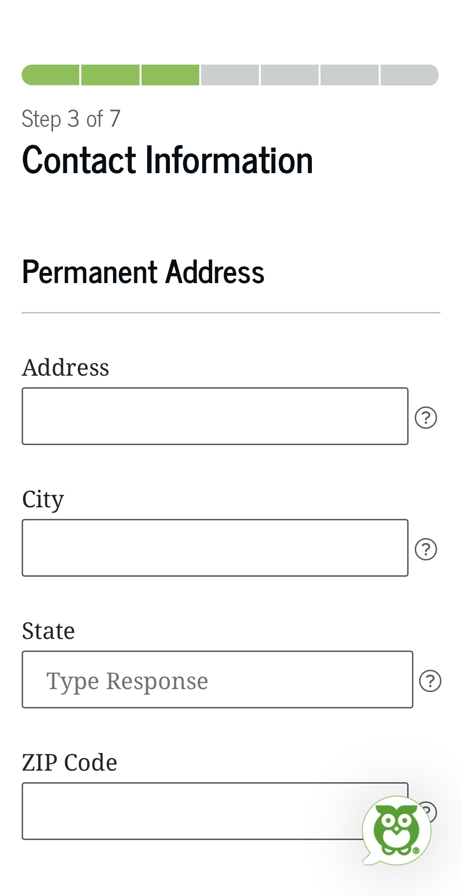
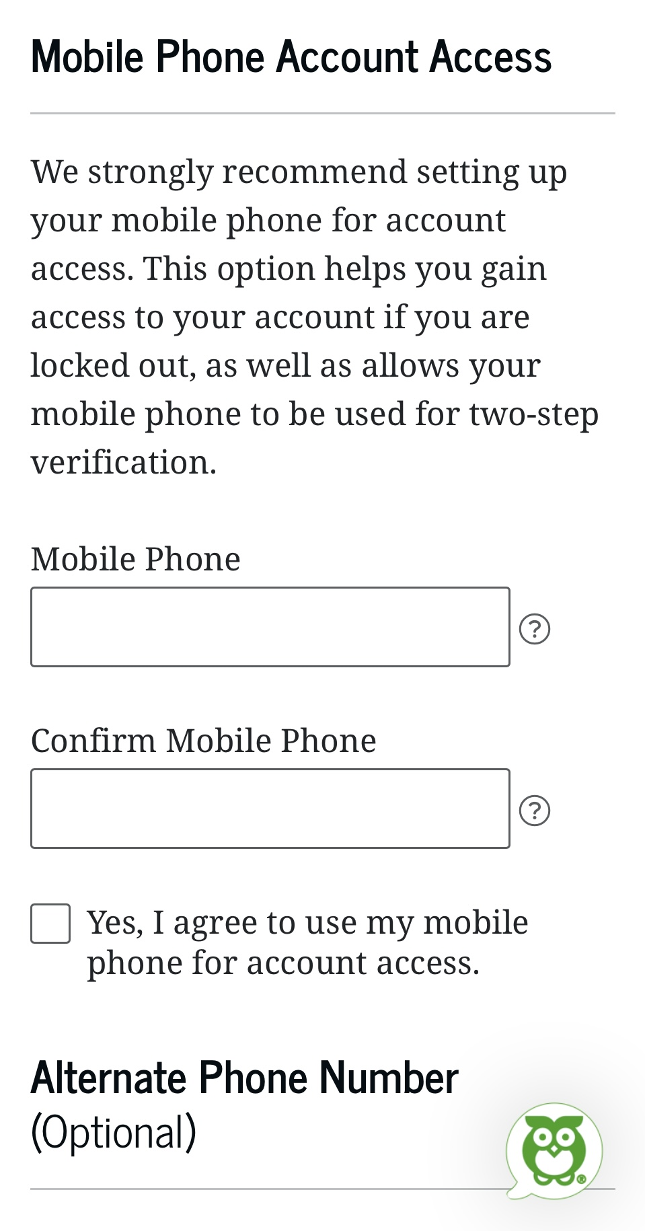
Step 03
Fill out your contact information to be able to receive FAFSA documents, news, and information

Slide 8
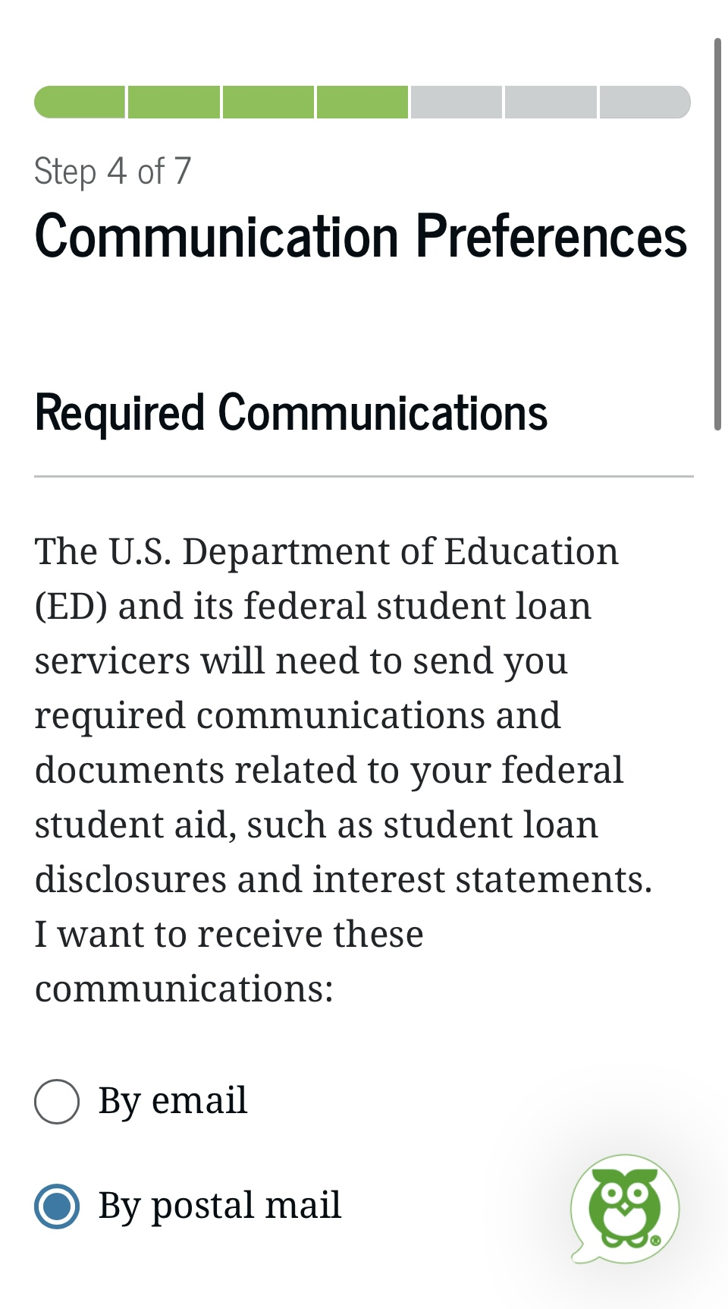
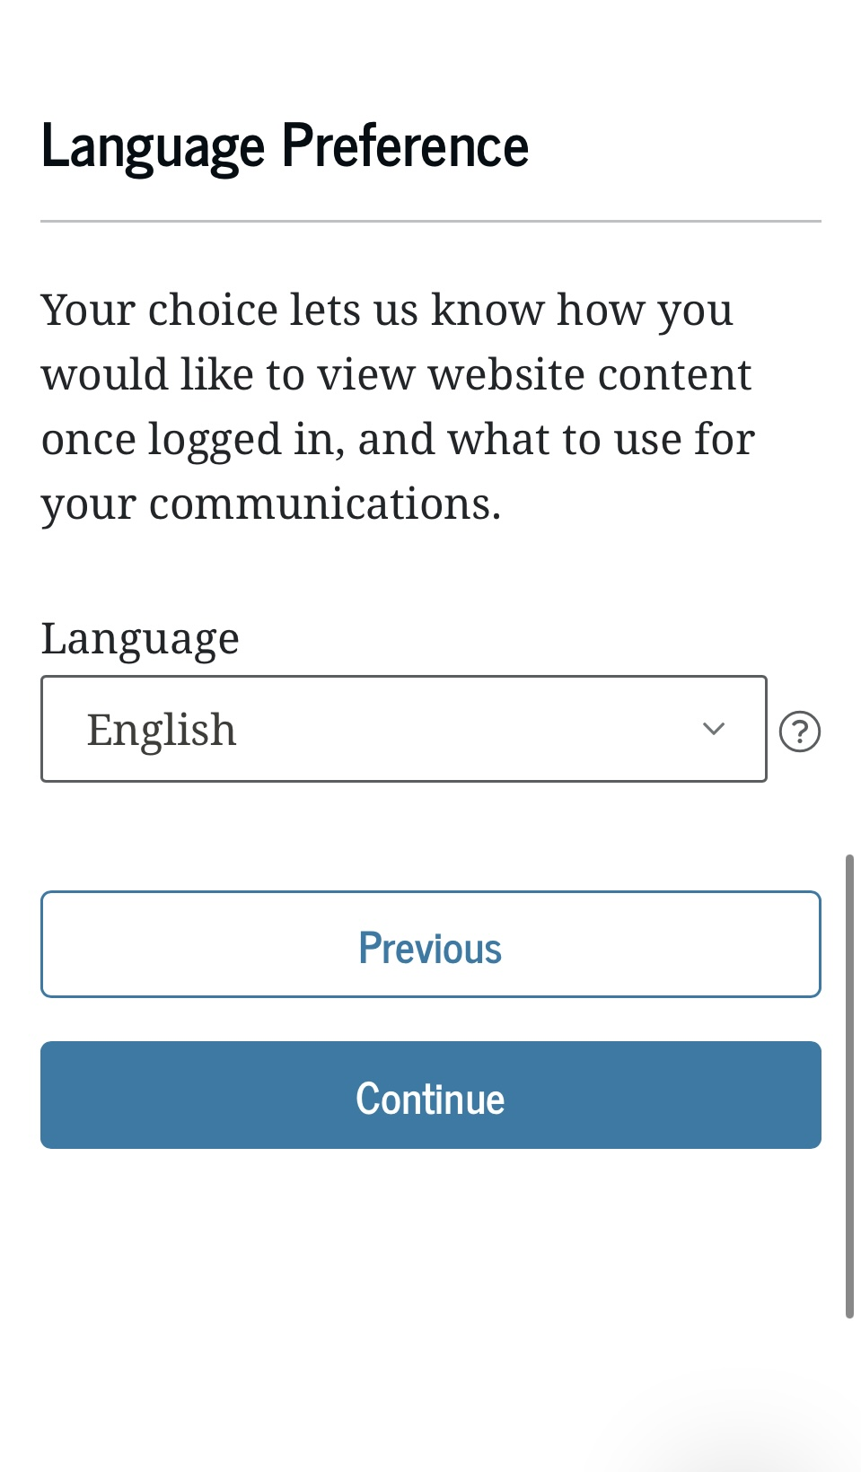
Step 04
Fill out the following steps based on how you want to receive your FAFSA results
Choose where you’d like to receive online info and guidance for FAFSA programs
Choose what language you’d like to fill out and receive your FAFSA results in

Slide 9
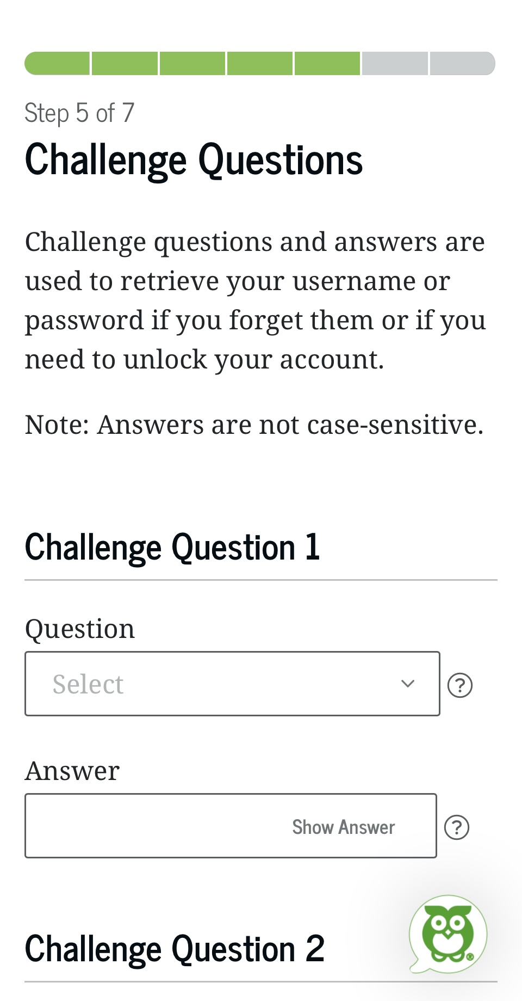
Step 05
Fill out 4 challenge questions and answers to secure the safety of your account

Slide 10
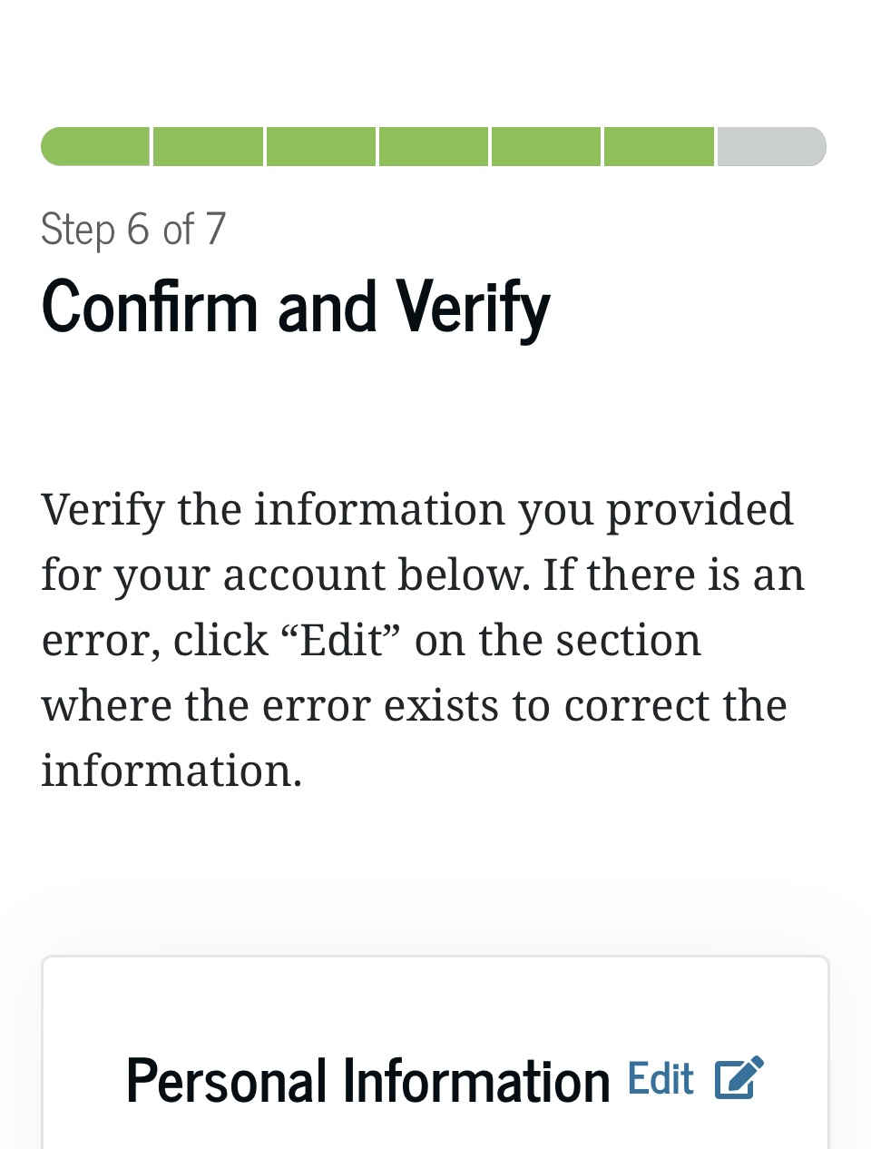
Step 06
Verify!
Check all the information that you’ve entered. If there are any errors push the “edit” button and fix them, if everything is correct push “continue”

Slide 11
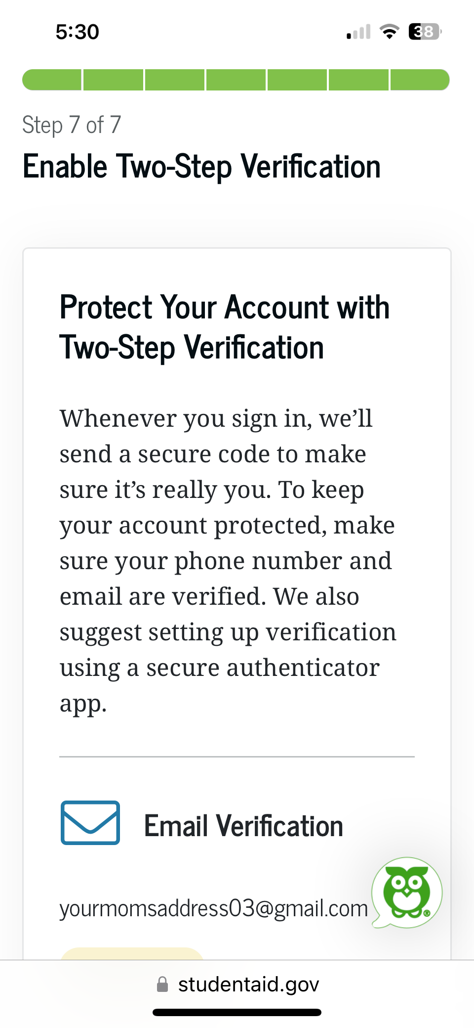
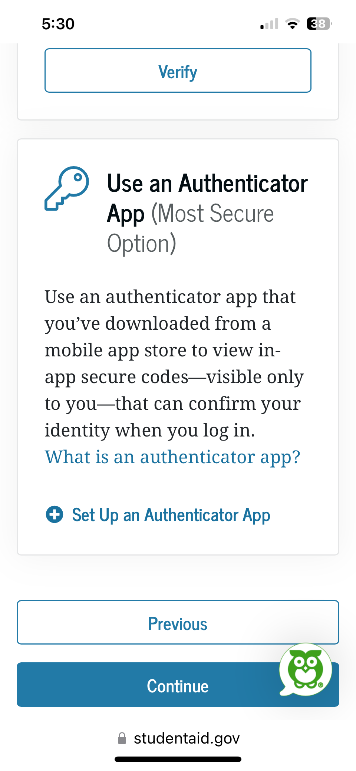
Step 07
Verify your phone number OR email for Two Factor Verification
An Authenticator App is NOT necessary, unless you would like to use one that you already have

Slide 12
Congrats, you are done! What now?
Your FSAID needs time to be verifed. In 3-5 days your FSAID should be good to go
Make sure to check your email in case there was an error
Remember your login credentials
Be ready to use your ID in December when FAFSA opens or during our FAFSA Application night in January!

Slide 13
What now?
If you were not prepared to complete your ID today, you now have the steps to do it on your own!
The process is simple and is easily understandable to complete. It’s just like making an account-except with your Social Security Number.
Your parents/ guardians will also need to create a FSAID of their own, if they do not already have one.
This ID will be linked to you during the FAFSA Application process.
Their FSAID must be made in their own name with their own information- just like you did today!

Slide 14

FAFSA Opens
December 10th
January 28th
The Free Application For Federal Student Aid is open on December 1st.
Join us at the IHS library to complete your FAFSA Application from 5:30-7pm.
You can also complete FAFSA on your own. There’s resources such as College Depot, College Connect Tempe, GCC, and Ask Benji on the IHS Career Center Website, or contact the peer coaches with questions.
Join us at the IHS library to complete your FAFSA Application from 5:30-7pm.

Slide 15
Coaches Contact Info
Mary Glauser
Melaena Martin
Noor Alkremi
Owen White
Mrs. Padia
Mglauser0950@student.pusd11.net
Mmartin0941@student.pusd11.net
Nalkremi8789@student.pusd11.net
Mrs. Brown
Julbrown@pusd11.net
owhite8632@student.pusd11.net
Email: dpadia @pusd11.net
Number: (623) 486 6422

Slide 16
Thanks!
Do you have any questions?
Contact any of us for answers! We’re available through the contact information provided in the last page and Mrs. Padia is available in the library’s Career Center for any extra guidance.
We are always happy to help

